Slide 1

The importance of SEO at BBC Sport

Slide 2
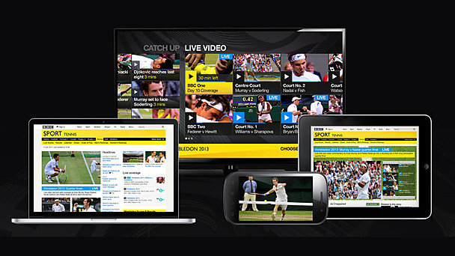

Slide 3
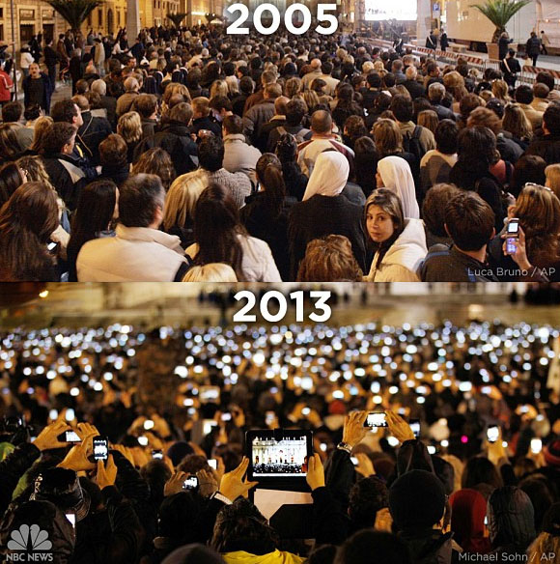

Slide 4
Headlines
Getting to the top of Google

Slide 8
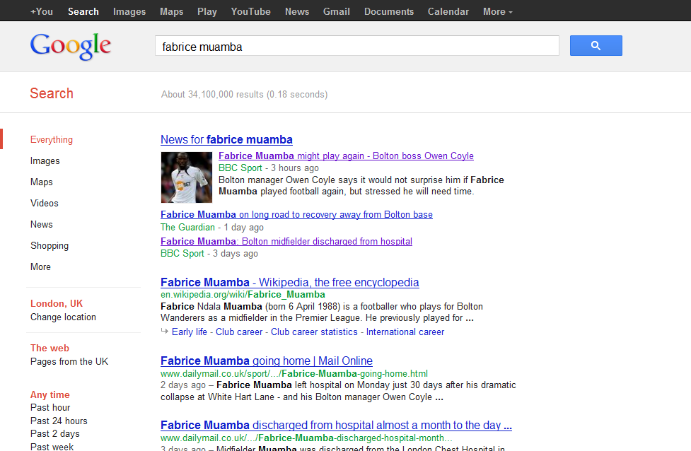
Google search result 19 April 2012

Slide 9
SEO kickers
Wimbledon 2012:
Euro 2012:
World Snooker Championship 2012:
Grand National 2012:
Boat Race 2012:

Slide 10
SEO kickers - exceptions
Always think about the individual
What would you search on search engine?
Examples

Slide 11
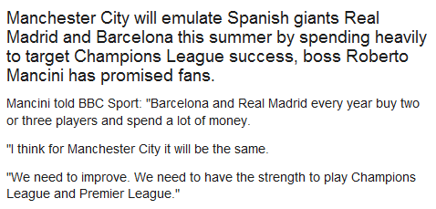
SEO – what’s the headline?

Slide 12
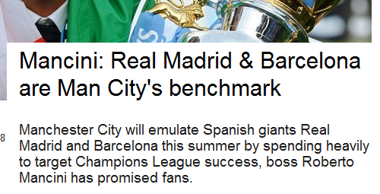
So what’s the headline?
Google search: Where BBC ranked
1st: Man City
2nd Roberto Mancini
1st Barcelona
1st Real Madrid

Slide 13
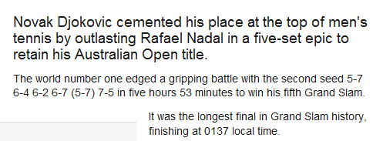
So what’s the headline?

Slide 14
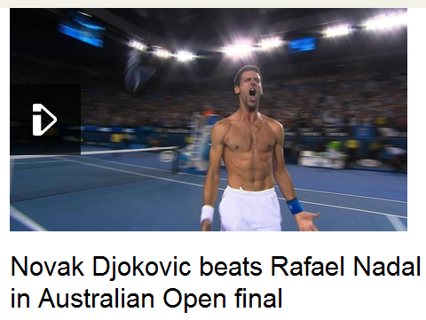
So what’s the headline?
Google search
1st Djokovic
1st Nadal
2nd Australian Open

Slide 15
Bear in mind
Story summary
How you name your picture
Captions and alt tags
Inline links to own content
Inline links to external content
Intros to stories
How you update stories
Features, Video and Audio
Planning for big events

Slide 16
The figures
Percentage of referrals from search engines
2011 – 9%
2012 – 12%
2013 – 15%
Transfer deadline day – 18.5% (1.7m)

Slide 17


